Slide 1
Claim History
29 August 2011
Notes:
Claim History - <number>
Guidewire training materials contain Guidewire proprietary information that is subject to confidentiality and non-disclosure agreements. You agree to use the information in this manual solely for the purpose of training to implement Guidewire software solutions. You also agree not to disclose the information in this manual to third parties or copy this manual without prior written consent from Guidewire. Guidewire training may be given only by Guidewire employees or certified Guidewire partners under the appropriate agreement with Guidewire.

Slide 2
Lesson objectives
By the end of this lesson, you should be able to:
  Explain claim history functionality
  Create custom claim history types
  Create custom claim history records
  Track individual field changes in Gosu
  This lesson uses the notes section for additional explanation and information.
  To view the notes in PowerPoint, choose View→Normal or View→Notes Page.
  If you choose to print the notes for the lesson, be sure to select “Print hidden slides.”
Notes:
Claim History - <number>

Slide 3
Lesson outline
Claim history basics
Writing custom history records
Tracking changes to fields
Notes:
Claim History - <number>

Slide 4
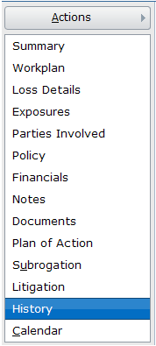
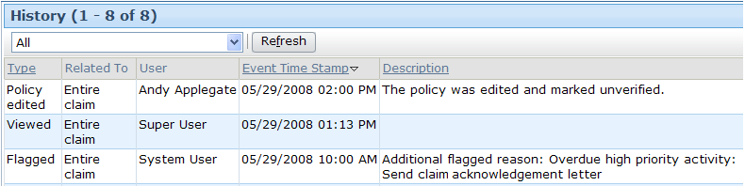
Claim history
A claim history is an uneditable record of important events and actions taken on the claim
Notes:
Claim History - <number>
Note that the claim history includes obvious entries (such as significant edits) as well as more trivial events such as viewing the claim.

Slide 5
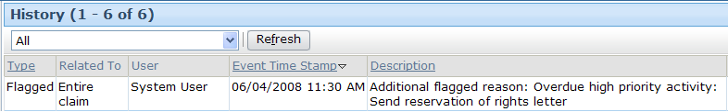
Claim history record
A claim history record is an entry in the claim history, documenting a single recordable claim event
Every history record has the following claim history fields:
  Type
  Related To
  User
  Timestamp
  Description
Notes:
Claim History - <number>
Claim history record fields
Type - The claim event causing the entry in the History table, such as it being opened, an exposure being closed or reopened, a stopped check, and so on.
Related To - Whether the event relates to the entire claim or one of its parts, like an exposure or reserve line.
User - Person who caused the event.
Time Stamp - Date and time the event occurred.
Description - A brief description of the event. This is provided for history entries written by ClaimCenter, and you add your own when you write rules that create custom history events.

Slide 6
Claim history type
History type is the claim event causing the history record to be created
  For example, the closing of a claim event produces a history record of type “closed”
ClaimCenter comes with standard history types that trigger automatically created claim history records
  Standard events may include editing, assigning, viewing, etc..
ClaimCenter may be configured to have custom history types, defining additional events to be added to the claim history
Notes:
Claim History - <number>
The base application claim history event types are defined in the HistoryType typelist. These history events will be generated by ClaimCenter by default regardless of configuration. More details on these event types can be found in the ClaimCenter Application Guide, under the Claim History section. Following is a complete list of the base types:
Mark for Archive
Restored
Assigned
Viewed
Catastrophe warning
Custom
Closed
Reopened
Flagged
Retrieved from queue
Imported
Activity due date changed
Opened Policy selected or refreshed
Policy Edited
Approval or Rejection
Activity escalation date moved
Check voided
Check stopped
Check deleted
Check transferred
Litigated

Slide 7
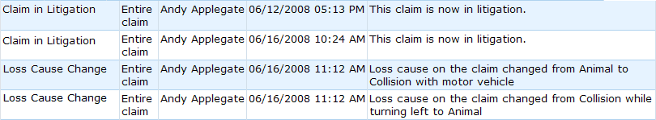
Common cases for custom history types
Tracking specific field changes
  For example, record when loss cause changes
Tracking specific claim situations that occur
  For example, litigation status set to “Litigated”
Notes:
Claim History - <number>
Why does the application need custom history types rather than just one “general” type? They are needed for filtering by type on the claim history page.
Note that in base ClaimCenter, the type displayed will always be "Custom" unless you configure the pcf to display your new type. The lab associated with this lesson has you perform that configuration.

Slide 8
Lesson outline
Claim history basics
Writing custom history records
Tracking changes to fields
Notes:
Claim History - <number>

Slide 9
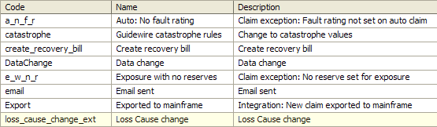
Custom claim history types
CustomHistoryType typelist defines history events that may be tracked by configured rules
  Some “custom” history types are predefined in the base application
  New custom history types can be added
Notes:
Claim History - <number>

Slide 10
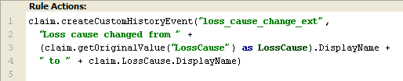
How to configure custom history records
Syntax
  Claim.createCustomHistoryEvent(CustomHistoryType, Text)
    Claim is the claim to which you are adding a history record
    CustomHistoryType is the history type
    Text is the text to be displayed on the history record
Notes:
Claim History - <number>

Slide 11
Lesson outline
Claim history basics
Writing custom history records
Tracking changes to fields
Notes:
Claim History - <number>

Slide 12
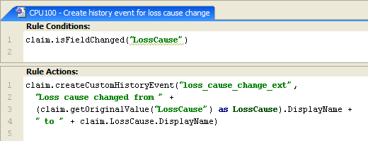
Checking for field changes
Syntax
  entity.isFieldChanged(“field”)
    Returns a Boolean
Notes:
Claim History - <number>
The parameter we send to isFieldChanged is a string. Ensure you are using the proper field name by using Intellisense (on a different line) or by checking the Data Dictionary.

Slide 13
Finding the original value
Syntax
  entity.getOriginalValue(“field”)
    Returns an ordinary object
    Need to cast the result in order to get the display name
Notes:
Claim History - <number>
The parameter we send to getOriginalValue is a string. Ensure you are using the proper field name by using Intellisense (on a different line) or by checking the Data Dictionary.

Slide 14
Lesson objectives review
You should now be able to:
  Explain claim history functionality
  Create custom claim history types
  Create custom claim history records
  Track individual field changes in Gosu
Notes:
Claim History - <number>

Slide 15
Review questions
What is a claim history?
Name three examples of claim history events.
Is it possible to define new types of history events?
Will any claim history records be recorded if no rules are written to configure it?
Notes:
Claim History - <number>
Answers
A claim history is an uneditable record of important events and actions taken on the claim.
Possible answers: Assigned, Viewed, Closed.
Yes. You add them in the CustomHistoryType typelist.
Yes, ClaimCenter automatically tracks a collection of recordable events, such as viewing the claim, editing the policy, and flagging the claim.

Slide 16
Notices
Copyright © 2001-2011 Guidewire Software, Inc. All Rights Reserved.
Guidewire, Guidewire Software, Guidewire ClaimCenter, Guidewire PolicyCenter, Guidewire BillingCenter, Guidewire Reinsurance Management, Guidewire ContactManager, Guidewire Vendor Data Management, Guidewire Client Data Management, Guidewire InsuranceSuite, Guidewire ContactCenter, Guidewire Studio, Gosu, Deliver Insurance Your Way, and the Guidewire logo are trademarks or registered trademarks of Guidewire Software, Inc. in the United States and/or other countries.
This material is Guidewire proprietary and confidential. The contents of this material, including product architecture details and APIs, are considered confidential and are fully protected by customer licensing confidentiality agreements and signed Non-Disclosure Agreements (NDAs).
This file and the contents herein are the property of Guidewire Software, Inc. Use of this course material is restricted to students officially registered in this specific Guidewire-instructed course, or for other use expressly authorized by Guidewire. Replication or distribution of this course material in electronic, paper, or other format is prohibited without express permission from Guidewire.
    Guidewire products are protected by one or more of the following patents: U.S. Patent No. 7,885,831; U.S. Patent No. 7,788,296.
Notes:
Introduction to Guidewire Configuration - <number>

